Slide 1
BFC3540
Modelling in Finance

Slide 2
Content
Let’s meet: Who I am. Who are you?
Subject Content & Resources.
Assessment.
Resources.
Introduction to VBA
First Lecture: Stat Properties of Equity Portfolios Part 1

Slide 3
Background: Paul Lajbcygier
Paul Lajbcygier holds a joint appointment as Associate Professor in the Department of Banking & Finance and the Department of Econometrics and Business Statistics.
His work focuses on computational finance, investments, asset pricing and market microstructure. He graduated from Melbourne High School and Melbourne University and completed his PhD from Monash University in 2001.
Paul has held appointments at The University of Oxford, New York University’s Stern School of Business and London Business School. He has published his research in leading global journals leading to hundreds of citations in leading journals.
Since 1990, Paul has provided investment advice for various domestic& international funds managers, banks and hedge funds.

Slide 4
BFC3540 Content Summary
BFC3540 combines finance, spreadsheets and programming. The emphasis is not on finance theory. Instead the objective of the subject is to understand how to solve real problems in finance using finance theory and statistics in a spreadsheet environment. Just like you will be required to do when you go to work!

Slide 5
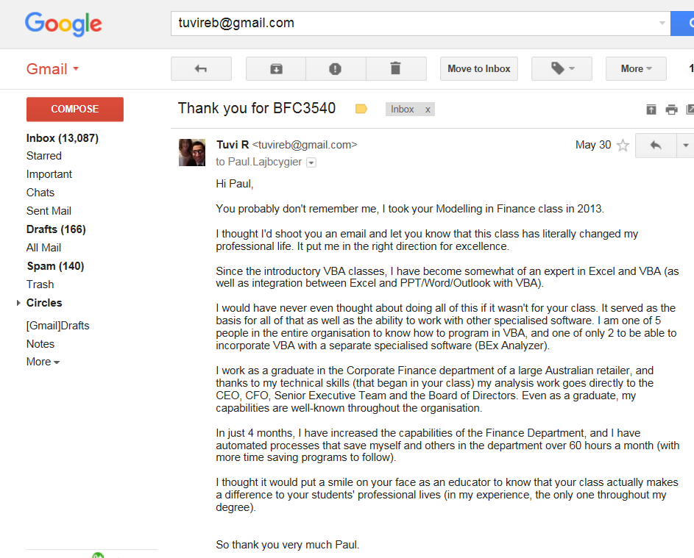

Slide 6


Slide 7


Slide 8
Assessment

Slide 9
‘Clever’ Assessment with prompt feedback is the key!
The principal tool used to change student behaviour and achieve deep learning goals is assessment. Research about higher education efficiency has a clear and simple message: what students do is completely motivated by assessment. It is possible to direct student focus via assessment. By implementing a weekly cycle of continuous assessment and feedback the hope was that students would achieve the deeper learning objectives of the subject.

Slide 10
BFC3540 Assessment
There are many micro-assessments per student for the semester! There is small, incremental assessment through-out the semester not just at a few pivotal points. You MUST work consistently through-out the semester. Each week relies on the previous weeks and builds on it. You cannot leave out topics. This is done for your benefit; students learn much better using this approach.

Slide 11

Summary of Assessment

Slide 12
Resources
There are lots of resources available to you to achieve success, including:
Standard resources: Text book, Moodle, Flux, etc.
Straightforward weekly homework which is assessed and designed to help motivate you;
YouTube Excel Movies to guide you through the weekly homework;
‘personalized’ feedback to tell you precisely where you went wrong in your homework the previous week; and much, much more!

Slide 13
Outline
Part 1: The statistical properties of a single asset portfolio.
Part 2: The statistical properties of a two-asset portfolio.
Part 3: The multi-asset portfolio

Slide 14
Part 1: Learning objectives for the single asset portfolio
To understand the statistical properties of a single asset portfolio.
To understand that stock returns are dispersed /distributed randomly, and that this implies non-predictability in returns.
To know how to measure and calculate the dispersion of stock returns: using mean and standard deviation.
To appreciate how dispersion effects the time series of stock returns and its relationship to risk.
To understand the relationship between risk and return.

Slide 15
Calculating returns
Arithmetic returns
Logarithm returns
Continuously compounded returns

Slide 16
Daily closing price of MSCI World Index
Daily closing price of MSCI (World) Index, 1 January 1985 – 18 June 2003.

Slide 17
Prices are ‘non-stationary’
The series y_{t}, t = -…-2, -1, 0, 1, 2,… is (weakly) stationary if:
for all t.
for all t.
for all i and any j. ie, the autovariance (or autocorrelation) between two points in the series depends only on the time between the two periods.

Slide 18
Stationarity implies…
A stationary series should:
Always move around the same constant level.
Have stable variation over time.
Not display any strong patterns over time, such as trends or a strong seasonal pattern in either the mean or the variance.
→ A stationary series is well summarised by its histogram

Slide 19
Returns and Stationarity
In general, most price series are nonstationary.
Stationarity can be achieved by transforming to returns.

Slide 20
Stock A’s distribution is similar to the Normal Distribution
‘Bell Shaped’
Symmetrical
Mean, Median and
Mode are Equal
‘Random Variable has
Infinite Range
f(Return)
Return
μ
Mean Median Mode

Slide 21
The Mathematical Model
2
1
(-1/2)
((X- μ)/σ)
fX) =
e
2π σ
f(X) = frequency of random variable X
π = 3.14159; e = 2.71828
σ = population standard deviation
X = value of random variable (-∞ < X < ∞)
μ = population mean

Slide 22
Many Normal Distributions
There are an Infinite Number
Varying the Parameters σ and μ, we obtain Different Normal Distributions.

Slide 23
Discrepancies between a normal distribution and actual stock return distributions
Leptokurtic (i.e. fat tails)
Skewed
heteroskedastic (i.e. not constant standard deviation)
Non-stationary

Slide 24
100 years of US Stock data
The properties of 22,474 daily observations on a US stock index.
The data appears to be stationary, but with a changing variance.
The mean is virtually zero, and the standard deviation 0.0106.
Note that for this data while the maximum return is larger in magnitude than the minimum return, the distribution is close to symmetric or only slightly negatively skewed.
The fundamental characteristic of the data is the excess kurtosis, which while attenuated by the removal of the extreme values, is still the basic feature.
The Jarque-Bera test rejects Normality (the 5% critical value is 5.99).

Slide 25
Non-normality
As famously stated by Fama in The Theory of Finance, “…if daily returns were drawn from Normal distributions, for any given stock a daily return greater than four standard deviations from the mean is expected about once every 50 years. (In fact) daily returns this extreme are observed about four times every five years. Similarly a daily return greater than five standard deviations from the mean is expected about once every 7,000 years. Such observations seem to occur about every three to four years.”

Slide 26
Calculating the mean and standard deviation using Excel
To calculate the mean use the Excel comman =average( )
To calculate the variance use the Excel command: =varp( )
To calculate the standard deviation use the Excel command: =stdevp( )

Slide 27
The relationship between risk and return
The assumption underlying this principle is that investors are risk averse
A risk averse investor is an investor who will only accept a higher level of risk if they expect to be compensated with a higher return

Slide 28
Sources of risk
The greater the variability in past returns, the greater the historical risk of a security
The greater the expected variability in future returns, or the greater the chance the actual return will differ from the expected return, the greater the expected risk of a security
Risk as a measure of variability in returns is commonly referred to as total risk
There a number of specific types of risk that give rise to or are sources of total risk

Slide 29
Sources of risk
Six specific sources of total risk are:
Market risk
Interest rate risk
Business risk
Financial risk
Default risk
Liquidity risk
There are many others, but we will focus on these six

Slide 30
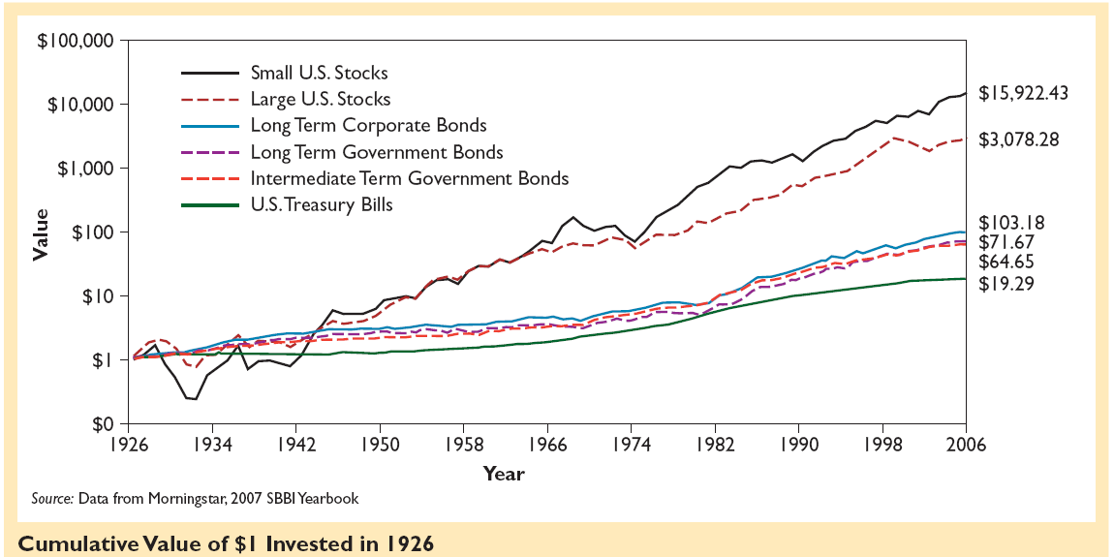
The historical performance of different security classes

Slide 31
Which company is more risky?

Slide 32
Which company is more risky?

Slide 33
How does dispersion effect time series properties of a stock?
Standard Deviation
Large Small

Slide 34
Risk and standard deviation
Given two distributions with the same mean but different standard deviations which would you rather own?
The smaller standard deviation stock is preferable - it is less risky and the expected return is the same as the high risk stock.
To see why standard deviation is a good proxy for risk: imagine having to sell the stock at some random time: for a high s.d stock you may sell it at its lows.

Slide 35
Conclusion to part 1
We have seen that stock prices are distrubuted randomly.
The (log) normal distribution is a good approximation to this empirical distribution.
The normal distribution does not perfectly replicate the empirical distribution.
Standard deviation is a good proxy for risk.

Slide 36
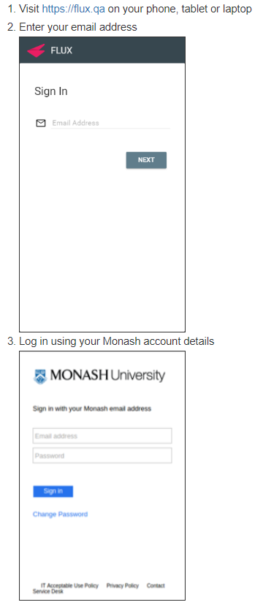

How to Login to FLUX

Slide 37
Homework Task Context
We talked about average returns earlier in the lecture.
You are given average returns and for each stock find the Excess return which is the difference between the Return in a week and the average return across all weeks.

Slide 38
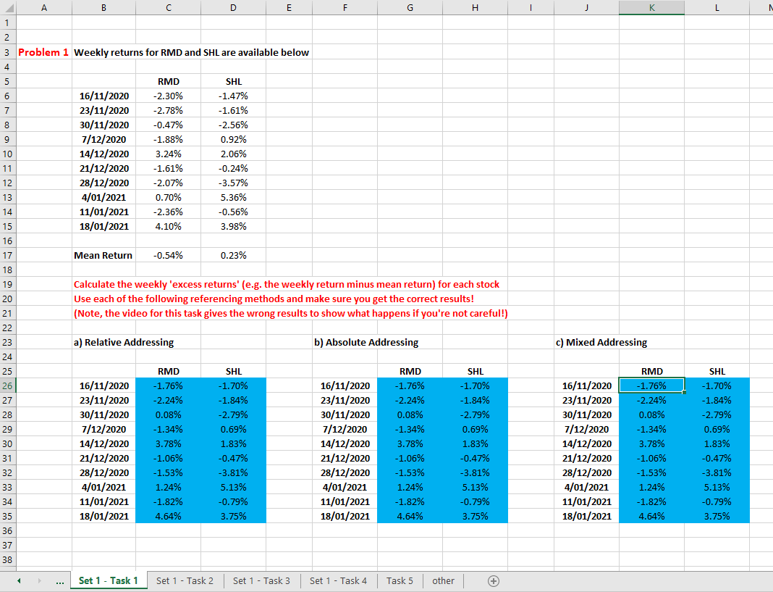
Week 1, Task 1, Set 1 Excel WorkSheet (set based on name)

Slide 39
Excess Returns: Relative, Absolute & Mixed Adressing
The first homework Excel Workbook SS1_3540_S1_2023 five different tasks, one in each Worksheet of the Workbook.
Procrastination is a human trait which I suffer… the best way around it is to start!
Therefore, my goal is to get you started on the first task, Task 1, now!

Slide 40
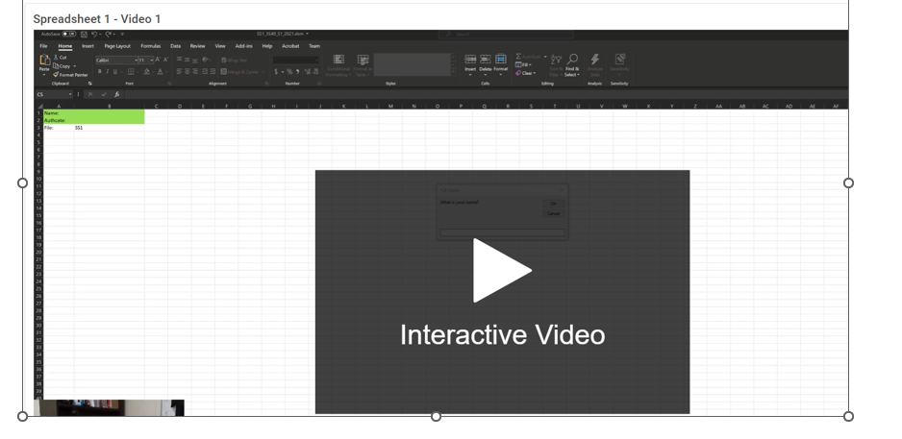
Excel Week 1 Spread Sheet Video on Moodle

Slide 41
Relative, absolute & mixed addressing in Excel
The first Task, Task 1, focuses on relative, absolute & mixed addressing.
What’s the difference between each form of addressing in Excel?
Let’s compare C26 (=C6-C17) with G26 (=C6-$C$17).

Slide 42
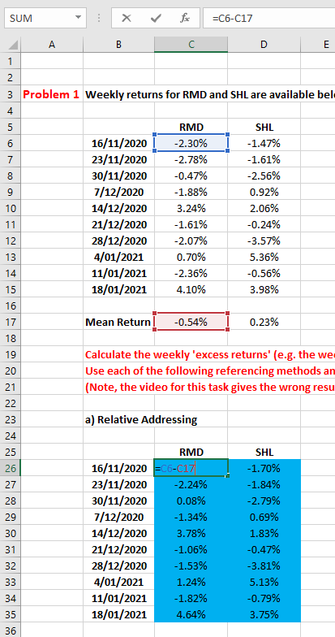
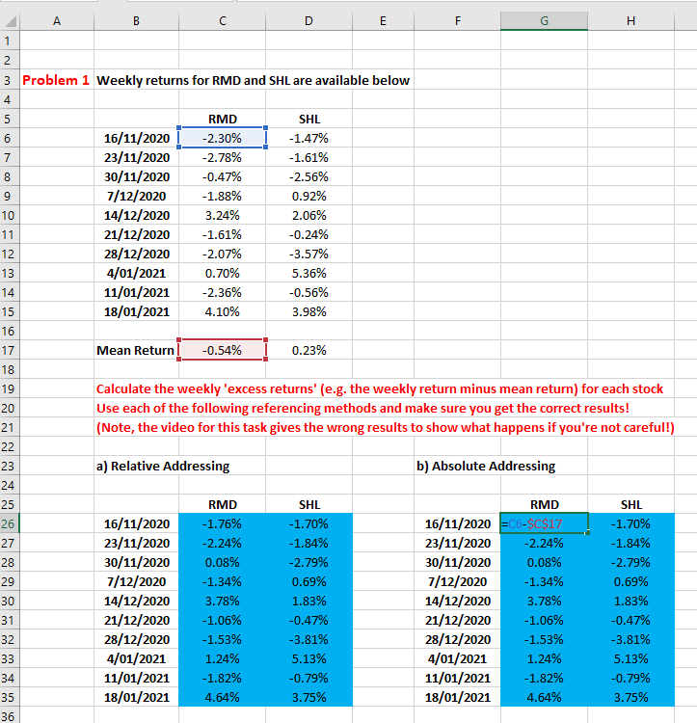
Compare Cells: C26 & G26

Slide 43
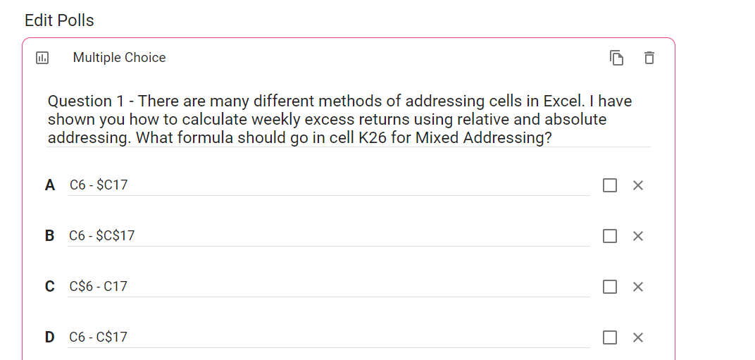
Flux Question (First Attempt)

